Slide 1
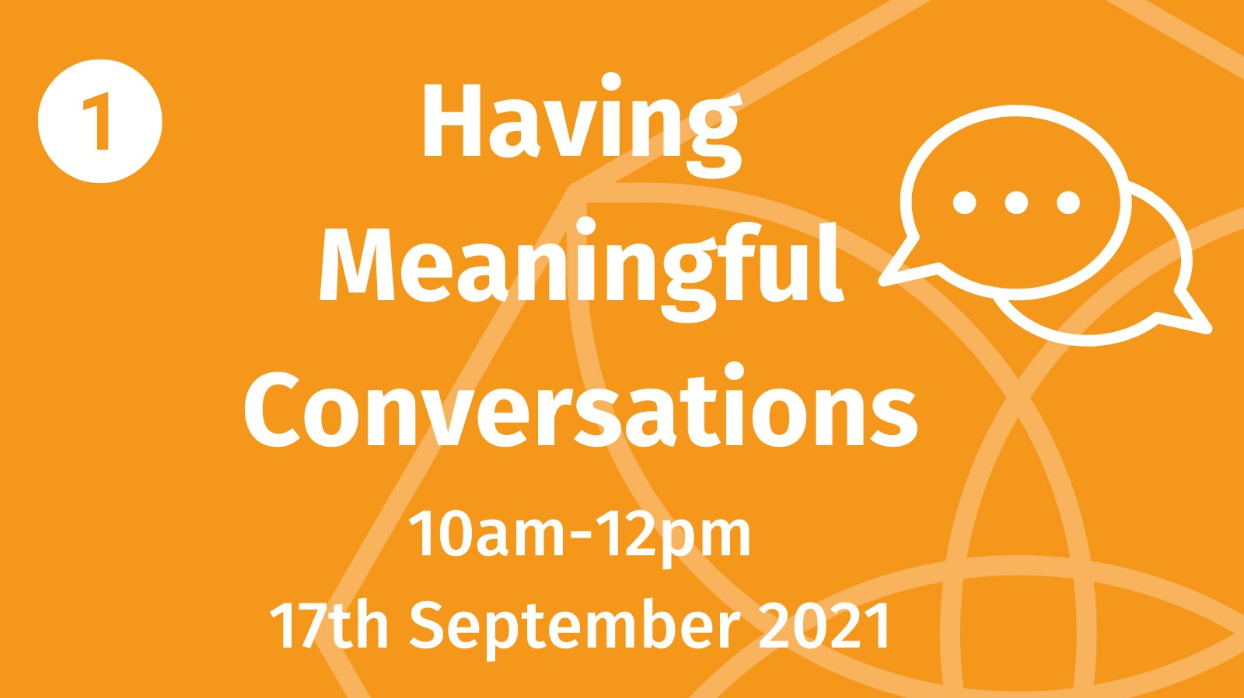

Slide 2
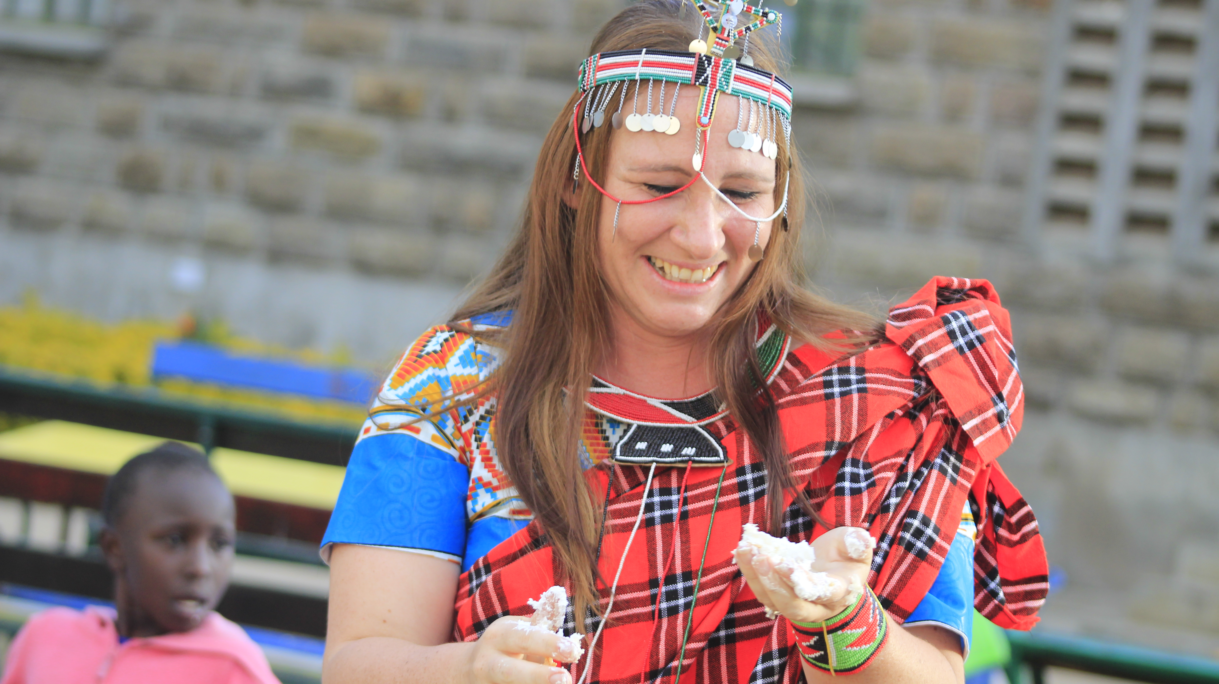

Slide 3
Workshop Breakdown
Introductions: Breakout Room/Jamboard Activity
Voices That Matter/Contributors to the Conversation
Our Voice Matters Findings: Conversation Flow and Residents Top Tips
Jargon Busting: Breakout Room/Jamboard Activity
Accessible Communication Research and Video
The Conversation Journey
Supporting People Before, During and After a Conversation: Breakout Room/Jamboard Activity
Citizens Priorities Toolkit
1 Positive Change: Breakout Room/Jamboard Activity
Summary and Close

Slide 4
Breakout Room/Jamboard Activity 1: Introductions
15 minutes
Get to know the people in your breakout room
Discuss the statements on the Introductions Slide (Slide 2) on the Jamboard – is there any that jump out at you, what do they mean to you, what do they mean in the context of your work, how do they relate to our topic of having meaningful conversations?

Slide 5
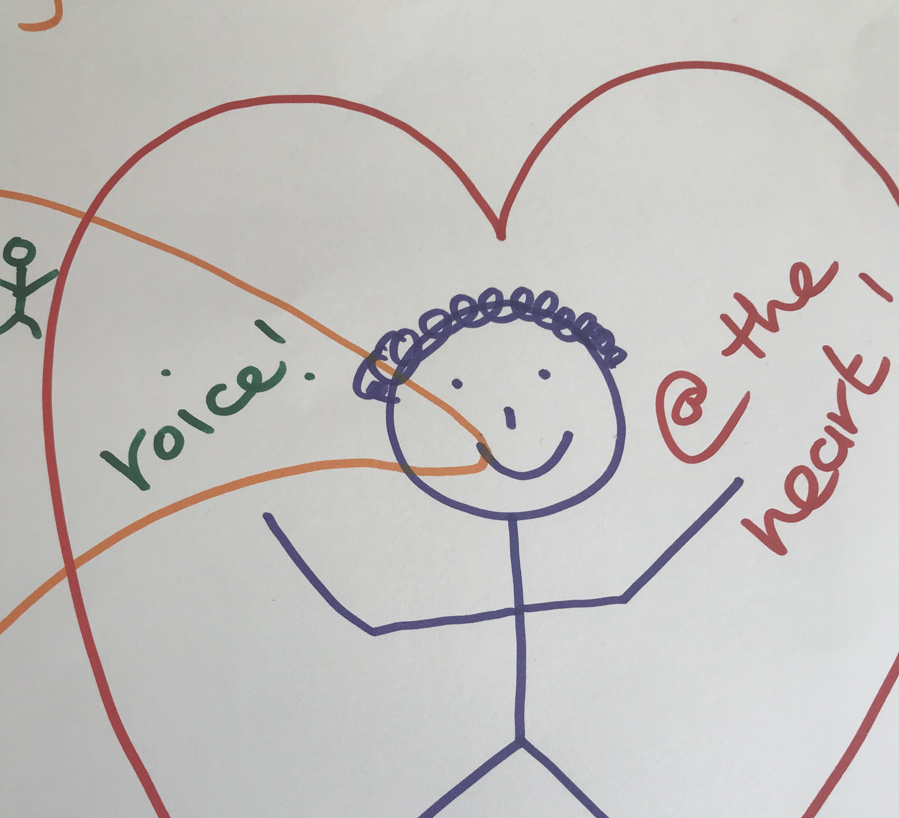
Who are the voices that matters?
At the heart of Engagement and meaningful conversations are people!
People are different, unique, individual and therefore there cannot be a one size fits all approach to our conversations and engagement activities
This diversity also means that everyone has a valid, valued and unique contribution to make

Slide 6
Contributors to the Conversation
Teachers
Victims
Public Sector
Older People
Professionals
Media
Communities
Academics
Carers
Social Services
Voices that Matter
Volunteers
Support Agencies
Health Care Sector
Third Sector
Young People
Service Users
People with Physical Disabilities
Local Authorities
People with mental health problems
Religious Leaders
Voluntary Organisations
Job Centre
Politicians
Refugees
Business Owners
Parents
People with Learning Disabilities
Housing Associations
People with Sensory Impairments

Slide 9
Breakout Room/Jamboard Activity 2: Jargon Busting
10 minutes
Look at the Jargon words (identified by People with Lived Experiences) on slides 3-7 of the Jamboard
Reflect on and discuss each word:
What do you think about when you see each word
What emotions come to mind when you consider each word
What images could be used to showcase the meaning of each word
What word(s) could we use instead

Slide 10
"Needs to be an authentic process so we can see an outcome and feel genuinely part of it"
"Sometimes I've not got the confidence to speak ... and I think other people don't have the confidence to speak to us ... so nothing gets said"
"I have seen when
other's wont let people
have a chance to speak
and say what they feel
- communication breaks
down"
"There should be equal respect up and down. Respect and listening should be both ways".
"Building trust so that
we feel comfortable
helps us to have
a voice"
"I feel relieved. When I understand something, I don’t get stressed or frustrated.”

Slide 11
Research highlights (approx. 500 people)
Self-advocacy should always be the first point of call - however not always possible
People’s views should be sought to have a tangible impact on their lives.
A one-size-fits-all approach to engagement & communication inevitably excludes some people
Cast wide nets out in the community to gain a true understanding of who our communities are and what is affecting them.
Know Your Audience: when speaking and including people in your work, adapt your material to how people understand, not necessarily how they communicate

Slide 12
Please use this link to access the Accessible Communication film created by Cwm Taf People First as well as their research findings report:
http://www.ourvoicematters.org.uk/learning-disabilities/accessible-communication-research/

Slide 13
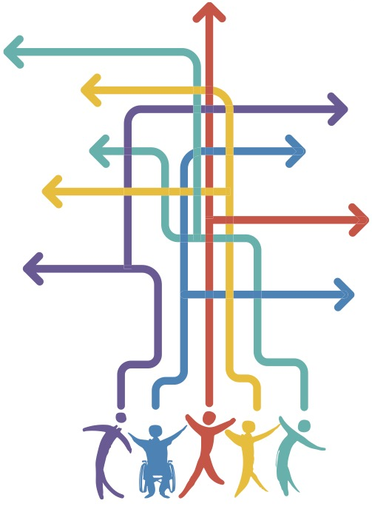
The Conversation Journey
Not just a one off
Building Relationships and Developing TRUST
Inspiring Action
Feedback
Revisit and/or Build
SUPPORT

Slide 14
Breakout Room/Jamboard Activity 3: Supporting People
15 minutes
Use Jamboard slides 8-10 to reflect on how we could support people Before, During and After a conversation or engagement activity

Slide 15
Purpose of the Toolkit
To provide opportunities for the people living in Cwm Taf Morgannwg to tell decision makers What Matters To Them
To inform partner organisations what/type of information we are looking for
To provide ideas of conversation starters through the suggested activities

Slide 16
Breakout Room/Jamboard Activity 4: 1 Positive Change
10 minutes
Claim a Jamboard slide from slide 11 onwards by typing a breakout room team name at the top of the slide
Make sure you use a slide that is not being used by another team (otherwise things might get confusing!)
Decide as a team what 1 positive change you would like to see happen
Work through the template to tell us what, why, how and who to make you change a reality

